Slide 1
OBESITY मोटापा
Dr Amarjeet
Professor in physical Education
Sarvoday p. g. College,
Ghosi, MAU

Slide 2
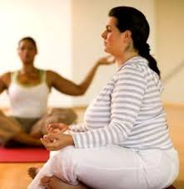
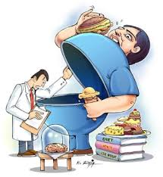
OBESITY मोटापा
जब अत्यधिक शारीरिक वसा शरीर पर इस सीमा तक एकत्रित हो जाती है कि वो स्वास्थ्य पर हानिकारक प्रभाव डालने लगती है ।
ऐसी अवस्था है जिसमे वज़न बढ़ने की वजह से आपके शारीरिक रूप में बदलाव भी आता है और आपके शरीर में अन्य रोगों को जन्म भी देता है । इस बीमारी में अत्यधिक मात्रा में चर्बी (fat) आपके शरीर में जमा होना शुरू हो जाता है ।

Slide 3
How to Get Your Ideal Weight
Ideal Weight Methods
Height Weight Chart
BMI
BIA
Skin Fold Method
Circumference Method

Slide 4
BMI Calculation
BMI Metric Formula
weight in kilograms
BMI = --------------------------
(kg/m²) height in meters²

Slide 5
BMI Chart
BMI Weight Status
Below 18.5 - Underweight
18.5 -24.9 - Normal
25 - 29.9 - Overweight
30 – 34.9 - Obese I
35 – 39.9 - Obese II
Above 40 - Obese III

Slide 6
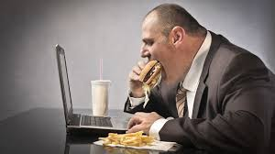
Causes of obesity मोटापे के कारण
आज कल लोग शारीरिक रूप से सक्रिय नहीं होते है और खासकर बच्चे अब बाहर खेलने-कूदने के बजाय कंप्यूटर, मोबाइल और वीडियो गेम खेलना अधिक पसंद करते हैं । जिससे बच्चों में भी मोटापा बढ़ता जा रहा हैं । सिर्फ बच्चे ही नहीं, ऑफिस जाने वाले युवा भी आज निष्क्रिय जीवनशैली जी रहे हैं, जिससे मोटापे जैसी समस्या हो रही है ।

Slide 7
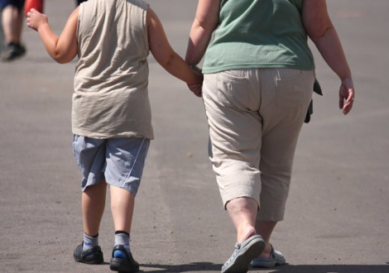
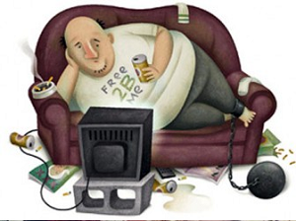
CAUSES OF OBESITY मोटापे के कारण
Genetics / Hereditary अनुवांशिक
Sedentary Lifestyle शारीरिकनिष्क्रियता
Lifestyle जीवनशैली
Diets खान-पान
Stress तनावग्रस्त
Pregnancy गर्भावस्था Diseases बीमारी
Medicine दवा Age उम्र Intoxication नशा

Slide 8
मोटापे के लक्षण
नींद न आना |
सांस की कमी महसूस होना |
आपकी त्वचा की परतों में जमा होने वाली नमी के कारण त्वचा की समस्याएं|
पित्ताशय पथरी |
वजन के असर से जोड़ों में गठिया रोग खासकर घुटनों में |
सांस जल्दी फूलना !
बहुत ज्यादा पसीना आना !
खर्राटे लेना !
जरुरत से ज्यादा या कम सोना |
आत्मविश्वास और आत्मसम्मान की कमी !

Slide 9
मोटापे से स्वास्थ्य पर प्रभाव
टाइप 2 मधुमेह
अत्यधिक कोलेस्ट्रॉल
उच्च‍ रक्‍तचाप
गठिया
कोरोनरी ह्रदय का रोग
हार्मोनल असंतुलन
कैंसर

Slide 10
मोटापे से स्वास्थ्य पर प्रभाव
नींद में परेशानी (snoring, and increase in
day-time sleep)
घुटनो के जोड़ों में दर्द
सांस फूलना
गर्दन के पीछे, बगल में या श्रोणि हिस्से में चमड़ी में काले निशान (acanthuses)
पेट पर असाधारण, गुलाबी निशान (pinkish or purplish streaks)

Slide 11
OBESE BASED ON DATA FOR THE NATIONAL HEAITH SURVEY
STATES | MALE% | MALE RANK | FEMALE% | FEMALE RANK
PANJAB | 30.3 | 1 | 37.5 | 1
KERALA | 24.3 | 2 | 34 | 2
GOA | 20.8 | 3 | 27 | 3
TAMIL NADU | 19.8 | 4 | 24.4 | 4
A P | 17.6 | 5 | 22.7 | 10
SIKKIM | 17.3 | 6 | 21 | 8
MIZORAM | 16.9 | 7 | 20.3 | 17

Slide 12
H P | 16 | 8 | 19.5 | 12
MAHARAAHTRA | 15.9 | 9 | 18.8 | 6
GUJARAT | 15.4 | 10 | 17.7 | 9
U P | 9.9 | 17 | 12 | 18
INDIA | 12.1 | 14 | 16 | 15

Slide 13
asana आसन
योगासनों का सबसे बड़ा गुण यह हैं कि वे सहज साध्य और सर्वसुलभ हैं । योगासन ऐसी व्यायाम पद्धति है जिसमें न तो कुछ विशेष व्यय होता है और न इतनी साधन-सामग्री की आवश्यकता होती है । योगासन अमीर-गरीब, बूढ़े-जवान, सबल-निर्बल सभी स्त्री-पुरुष कर सकते हैं । आइये जानते हैं कुछ लाभकारी योग आसन जिससे मोटापा कम होता है ।

Slide 14
ASANA आसन
BHUJANGASANA भुजंगासन
Sarvangasana सर्वांगासन
Paschimottanasana Ikf”peksRrklu
Halasana हलासन
Naukasana नौकासन
Shalabhasana शलभासन
Pawanmuktasana पवनमुक्तासन
Dhanurasana धनुरासन
Surya Namaskar सूर्य नमस्कार

Slide 15
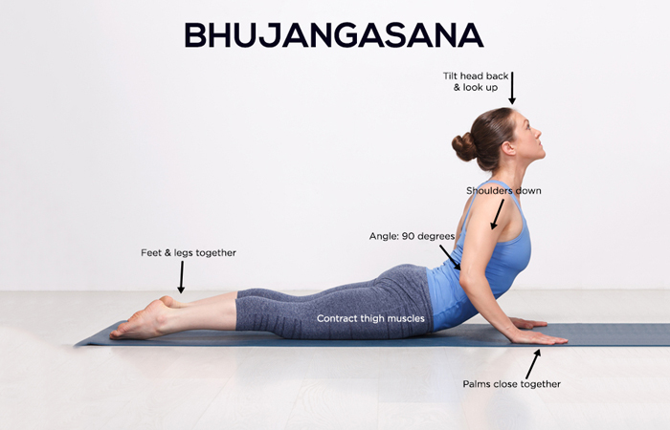
आसन का स्वास्थ्य पर प्रभाव
भुजंगासन Bhujangasana / Cobra Pose
It helps regulate metabolism, thus balancing the weight.
It makes the buttocks firm.
It gives the lungs, shoulders, chest, and abdomen a good stretch.
This asana is known to open up the lungs and the heart.

Slide 16
Precautions
Hernia
Back injuries
Pregnancy
Recent abdominal surgeries

Slide 17
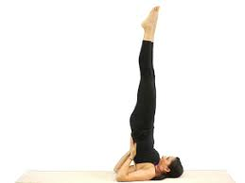
Sarvangasana (सर्वांगासन )
Benefits
1. Blood circulatory system, respiratory system and digestive system will be vivified.
2. While practicing this yoga pose more blood flows into throat, thyroid gland will be invigorated.
3. Sexual disorders are cured easily.
4. Hair loss and premature graying of hair are put to end or controlled.
5. Menstrual disorders, frequent abortions, leucorrhoea and barrenness in women are also cured.

Slide 18
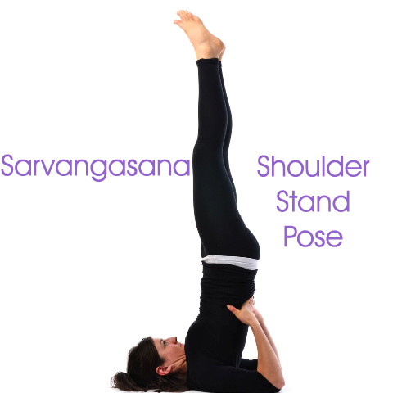
Precautions
1. High blood pressure
2. Heart problems
3. Capillary
4 Weak age
5. Spondylosis
6. Slipped disc

Slide 19
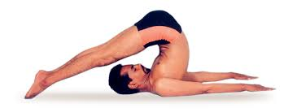
HALASANA हलासन
BENEFITS
.
1. It regulates metabolism and helps in weight loss
2. It helps reduce stress and fatigue.
3. This asana also helps to calm the brain.
4. It gives the spine and shoulders a good stretch.
5. It works on the thyroid gland as well..

Slide 20
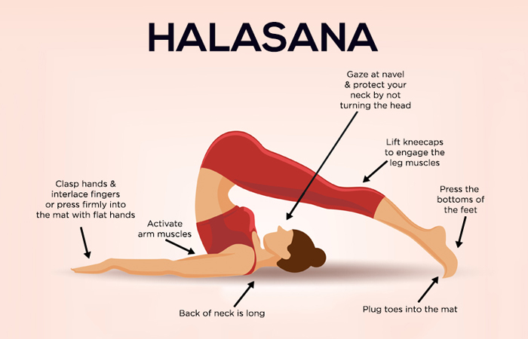
Precautions
1. Menstruation
2. Neck injury
3 .If you are suffering from high blood pressure and asthma, support your legs
4 .When you touch your feet to the ground, this asana becomes and advanced yoga pose. You must do this asana under the guidance of an experienced yoga teacher.

Slide 21
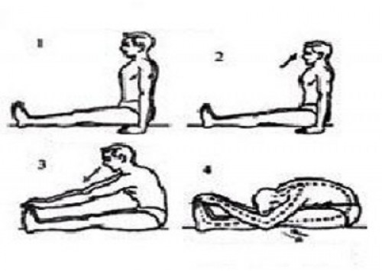
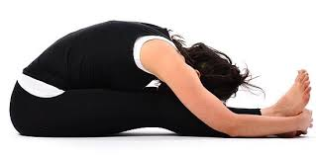
Paschimottanasana Ikf”peksRrklu Benefits
1) Paschimottanasana benefits you for strengthening your spine & back.
2) It is much useful asana for increasing height.
3) It works as most beneficial exercise for the working liver, kidneys, uterus & ovaries.
4) It reduces obesity, removes many ailments and increases appetite.

Slide 22
Precautions
1. Person suffering from back problem, Asthma & Diarrhea should avoid practice of Paschimottanasana.
2. Bend forward if you feel comfortable and easy.
3. If any surgery is done then avoid practicing Paschimottanasana

Slide 23
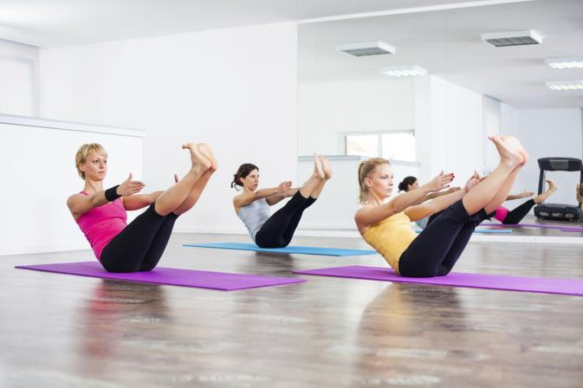
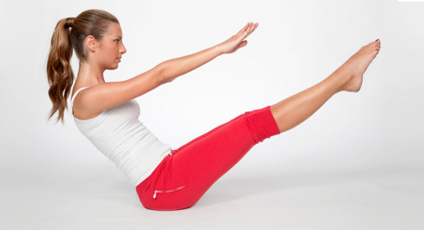
Naukasana नौकासन Benefits
Helps to reduce basely fat
Improve the function of digestion
Good for developing six pack ABS.
Regulates the function of pancreas, liver and lungs.
Strengthens abdominal muscles.

Slide 24
Good for diabetes patient to maintain the sugar level
Improves the blood circulation.
Strengthens the muscles of thigh, hips, necks and shoulder.
Improves thyroids and prostate glands.
Precautions
Hip joint pain, arthritis, hernia and ulcer patients should not practice Naukasana (Boat pose).
Consult a doctor first before practicing any exercise and practice under expert guidance.
Pregnant women should not practice this boat pose.

Slide 25
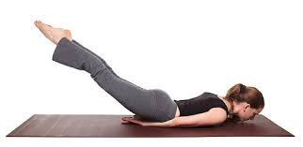
Shalabhasana शलभासन Benefits
is beneficial in all the disorders at the lower end of the spine.
Most helpful for backache and sciatica pain.
Useful for removing unwanted fats around abdomen, waist, hips and tights.
Strengthening your wrists, hips, thighs, legs, buttocks, lower abdomen and diaphragm.
Toughens back muscles.

Slide 26
Precautions
A person with High Blood Pressure is better to avoid this pose.
As this yoga pose puts lots of pressure on the abdomen it is strongly advisable for pregnant women not to attempt this asana.
Anyone suffering from Peptic Ulcer should not do this posture.

Slide 27
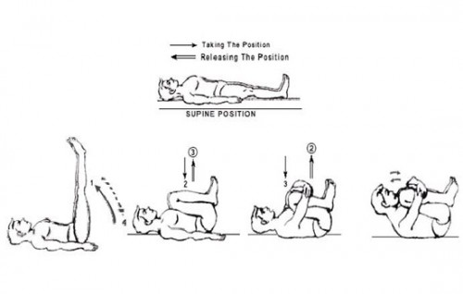
Pawanmuktasana Benefits
Ease tension in the lower back and loosens the spinal vertebrae.
It stretches the neck and back.
Help in release of gas, digestion, and constipation.
Due to compression of the abdominal muscles, blood circulation is increased internally.

Slide 28
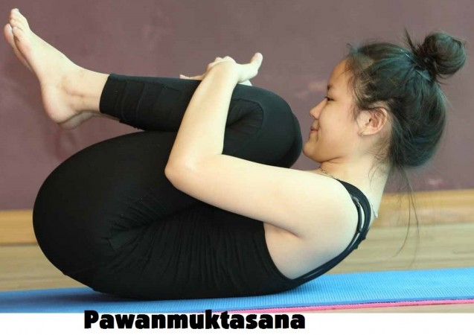
Precautions
Not recommended for those with abdominal surgery, or suffering from slip disc.
Pregnant women should not practice this asana.
Persons with neck and back problems, blood pressure problems should avoid it

Slide 29
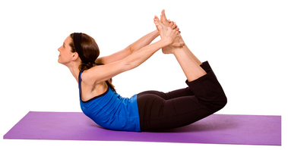
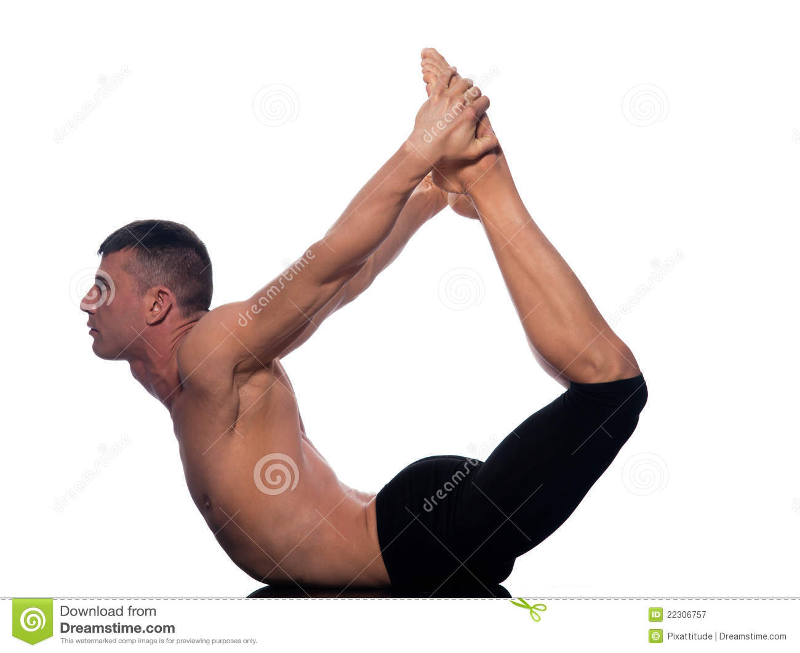
Dhanurasana Benefits
Improves blood circulation.
Gives flexibility to the back.
Strengthens back muscles.
Improve the function of liver, pancreas, small intestine and big intestine.
Improves digestion .

Slide 30
Act as a stress reliever.
Strengthens ankles, thighs, chest, and abdominal organs.
Improve function of kidney and liver.
It improves posture.
Releases back pain.
Precaution
The person suffering from high blood pressure, back pain, hernia, headache, migraine or abdomen surgery should not do practice Dhanurasana.

Slide 31
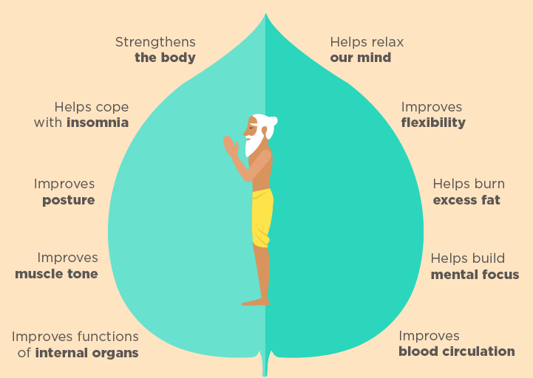
Surya Namaskar

Slide 32
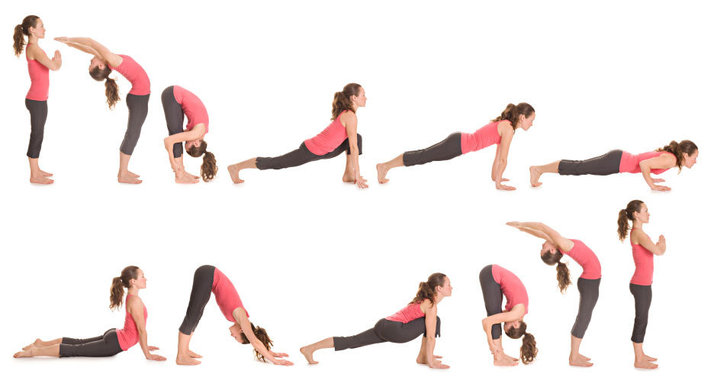

Slide 33
Precautions
1) This yoga practice must be performed empty stomach or after 3-4 hours of having meal.
2) Do not drink water or any other liquid material immediately before performing Surya Namaskar.
3)The best time to perform this yoga practice is in early morning between 5-8 but if one is not able to perform in morning can practice it any other time but the only caring point is not just after having meal.
4) Do not go for bath immediately after performing Surya Namaskar,there must be gap of at least 20-30 min between Surya Namaskar practice and taking Bath.The preferred practice is to first perform the Surya Namaskar then after 30 min go for bath.

Slide 34
Surya Namaskar Benefits
Improves Blood Circulation of the Body
Your Mantra to Weight loss
Promotes a Regular Menstrual Cycle
Benefits your Skin and Hair
Anti-anxiety and Calming Properties
Benefits of Surya Namaskar (Sun Salutation)
Effective in weight loss.
Increase the size of the chest and gives perfect shape.

Slide 35
HOW MUCH CALORIES ARE YOU BURNING IN YOUR
30 MINUTE WORKOUT?
Weight lifting = 199 calories
Tennis = 232 calories
Basketball = 265 calories
Beach volleyball = 265 calories
Football = 298 calories
Bicycling (14 – 15.9 mph) = 331 calories
Rock climbing = 364 calories
Running (7.5mph) = 414 calories
SURYA NAMASKAR = 417 calories

Slide 36
ASANA PRACTICE PROTOCOL
(1hr / 6 days/ 12 Weeks) Progressive load adopted
SL. NO. | NAME OF ASANA | DURATION | REPETITION | RECOVERY | VOLUME
01. | Bhujangasana | 60 sec.+ 60 sec. | 2+2 | (30+30+30+30) sec. | 6 mins.
02. | Sarvangasana | 60 sec. .+ 60 sec. | 2 +2 | (30 +30 +30+30 ) sec. | 6 mins.
03. | Paschimottanasana | 60 sec+ 60 sec. | 2+2 | (30 +30 +30+30) sec. | 6 mins.
04. | Halasana | 60 sec.+ 60 sec. | 2+2 | (30+30+30+30) sec. | 6 mins.
05. | Naukasana | 60 sec.+ 60 sec. | 2+2 | (30+30+30+30) sec. | 6 mins.
06. | Shalabhasana | 60 sec.+ 60 sec. | 2+2 | 30+30+30+30) sec. | 6 mins.
07. | Pawanmuktasana | 60 sec.+ 60 sec. | 2+2 | (30+30+30+30) sec. | 6 mins.
08 | Dhanurasana | 60 sec.+ 60 sec. | 2+2 | 30+30+30+30) sec. | 6 mins.
09. | Surya Namaskar | 120 sec | 4 | (30 +30 + 30 +30 ₊₂ ) sec. | 10 mins.
. |  |  | total |  | .60 mins.

Slide 37
REFERENCES
Guide, Motilal Banarsidas, 1989.
Lad, Vasant; Ayurveda: The Science of Self-Healing, Lotus Press, N.M., 1985.
2. Saraswati, Swami Satyananda ; Asana Pranayama Mudra Bandha, Bihar School of Yoga, Munger, 1993.(2) Frawley, David; Ayurvedic Healing: A Comprehensive Guide, Motilal Banarsidas, 1989.
Lad, Vasant; Ayurveda: The Science of Self-Healing, Lotus Press, N.M., 1985.
3. The Mayo Clinic: Counting Calories – Getting Back
4. Cohen DL. Yoga and hypertension. J Yoga Phys Their. 2013;3:144
5. Bear TK, Rajapurkar MV(1993). Body composition, cardiovascular endurance and anaerobic power of yogic practitioner, Indian Journal of Physiology & Pharmacology 37(3) 225-228
6. Calle–Pascual AL, Rodriguez C, Camacho F, Sanchez R, Martin-Alvarez E Yuste, Hidalgo I, Diaz
7. RJ, Calle JR, Charro AL(1992). Behaviour modification in obese subjects with type 2
8. Datey KK, Deshmukh SN, Dalvi CP, Vinekar SL(1969).
Angiology Research Foundation, Las Vegas 325-3336

Slide 38
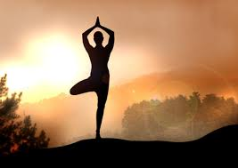
Thank You

